Slide 1
Bridging Theory and Practice in Parallel Clustering
Jessica Shi
Massachusetts Institute of Technology

Slide 2
Large-scale graph processing
Search applications, link analysis, impact factor, etc.
Fraud detection, credit risk modeling, money laundering detection, etc.
Disease expression, protein interactions, metabolic pathways, neuron interactions, etc.
Web graph
Financial transactions
Community detection, marketing opportunities, etc.
Biological networks
Social media network

Slide 3



Large-scale graph processing
Challenges:
Solutions:
Irregular memory accesses
Systems: Performance engineering
Large-scale
Parallelism
Work-intensive
Theory: Reduce work
Sequential dependencies
Theory: Eliminate sequential dependencies
Difficult to program
Systems: Real-world frameworks

Slide 4
My research
Theory
Differential privacy (FOCS ‘22)
Systems
Hierarchical agglomerative clustering (NeurIPS ‘22, ICML ‘21)
k-core + nucleus decomposition (SPAA Best Paper ‘22, VLDB ‘22)
Subgraph counting + peeling (ACDA ‘21, APOCS [‘23, ‘20], SEA ‘21, JEA ‘22)
Graph-based benchmark suite (GBBS) (GRADES-NDA ‘20)
Correlation clustering (VLDB ‘21)

Slide 5
My research
Theory
Differential privacy (FOCS ‘22)
Systems
Used in production at Google
Hierarchical agglomerative clustering (NeurIPS ‘22, ICML ‘21)
k-core + nucleus decomposition (SPAA Best Paper ‘22, VLDB ‘22)
Subgraph counting + peeling (ACDA ‘21, APOCS [‘23, ‘20], SEA ‘21, JEA ‘22)
Graph-based benchmark suite (GBBS) (GRADES-NDA ‘20)
Correlation clustering (VLDB ‘21)
Hierarchical agglomerative clustering (NeurIPS ‘22, ICML ‘21)
Graph-based benchmark suite (GBBS) (GRADES-NDA ‘20)
Correlation clustering (VLDB ‘21)

Slide 6
Computational barriers: Increasing graph sizes
hyperlink2012
225 billion edges
hyperlink2014
124 billion edges
Even larger privately-owned graphs:
Google (2018)
6 trillion edges
ClueWeb
74 billion edges
(in CSR format)

Slide 7
Parallelism
48 cores, 1.4 TB
$10.65 / hr
Up to hundreds of billions of edges
More cost-effective than distributed clusters
Even larger machines available:
224 cores, 24.6 TB
$261.73 / hour
30 cores, 240 GB
$3.13 / hr
Up to billions of edges

Slide 8
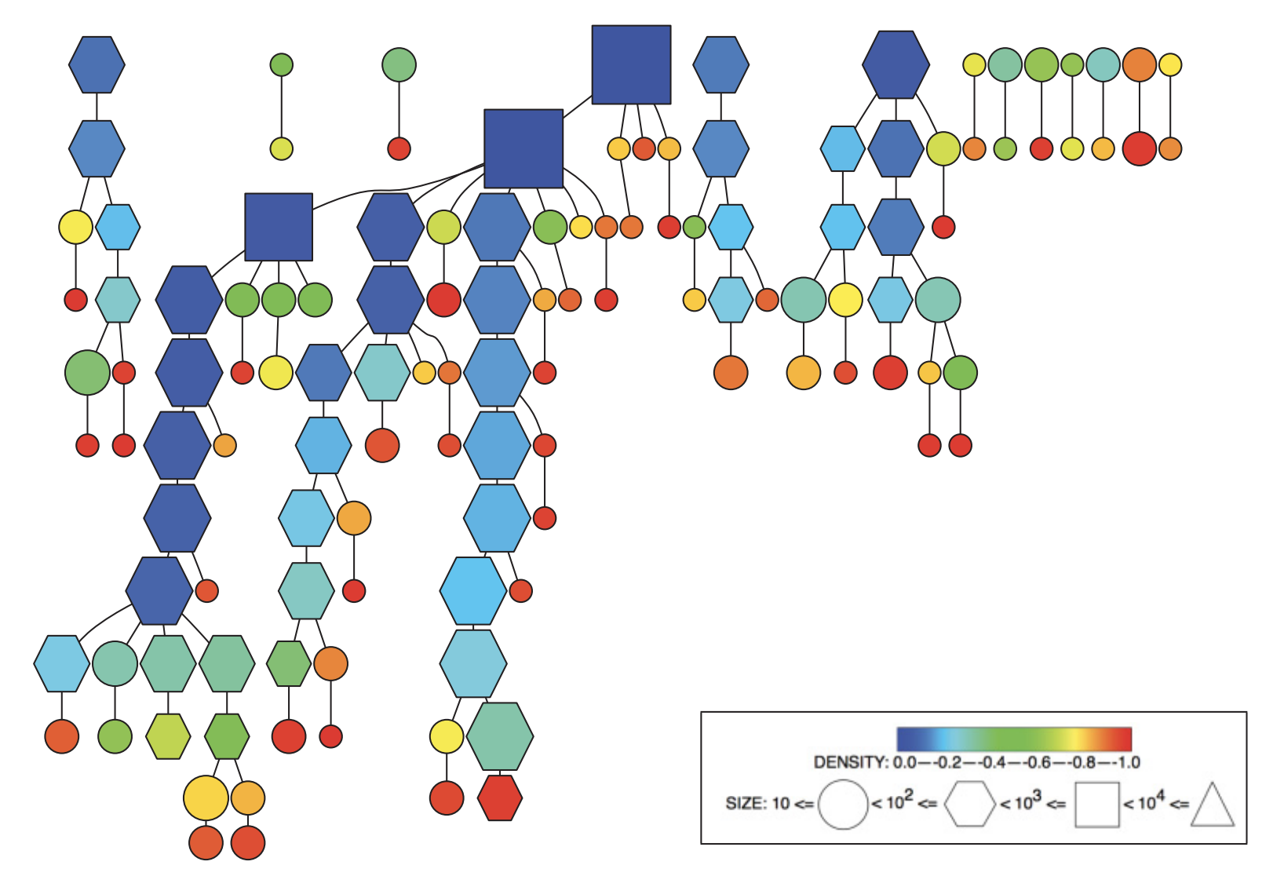
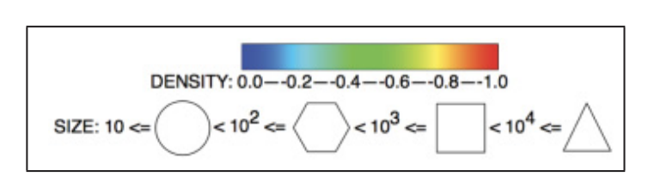
Nucleus decomposition
Nucleus decomposition: Finds hierarchical communities of ”densely connected” vertices
facebook graph (88k edges)
Sariyuce, Seshadhri, Pinar, Catalyurek (2017)

Slide 9
Computational barriers: Sequential subgraph decomposition can be slow
Environment: 30-core GCP instance (2-way hyperthreading), 240 GiB main memory
Goal: < 15 min
Graph | # Edges | Sequential (3, 4)-nucleus decomp ^{[1]}
as-skitter | 11 million | 8.5 minutes
livejournal | 34 million | 3.3 hours
orkut | 117 million | > 6 hours
[1] Sariyuce et al. (TWEB ‘17)

Slide 10
Theoretically efficient algorithms can be fast
3.3 hrs
Timed out
8.4 min
[1] Sariyuce et al. (TWEB ‘17)

Slide 11
Theoretically efficient algorithms can be fast
Previous parallel nucleus decomposition ^{[2]}: Not theoretically efficient
3.3 hrs
3.2 hrs
Timed out
1.3 hrs
8.4 min
3.7 min
[1] Sariyuce et al. (TWEB ‘17)
[2] Sariyuce, Seshadhri, Pinar (VLDB ‘18)

Slide 12
Theoretically efficient algorithms can be fast
Previous parallel nucleus decomposition ^{[2]}: Not theoretically efficient
3.3 hrs
3.2 hrs
Timed out
1.3 hrs
14 min
21 min
8.4 min
3.7 min
50 sec
[1] Sariyuce et al. (TWEB ‘17)
[2] Sariyuce, Seshadhri, Pinar (VLDB ‘18)

Slide 13
Practical optimizations
Timed out
3.3 hrs
3.2 hrs
1.3 hrs
21 min
8.4 min
14 min
13 min
3.7 min
3.3 min
50 sec
24 sec
[1] Sariyuce et al. (TWEB ‘17)
[2] Sariyuce, Seshadhri, Pinar (VLDB ‘18)

Slide 14
My research
My research combines theory and practice to construct scalable, real-world systems
Theory
Differential privacy (FOCS ‘22)
Systems
Hierarchical agglomerative clustering (NeurIPS ’22, ICML ‘21)
k-core + nucleus decomposition (SPAA Best Paper ‘22, VLDB ‘22)
Subgraph counting + peeling (ACDA ‘21, APOCS [‘23, ‘20], SEA ‘21, JEA ‘22)
Graph-based benchmark suite (GBBS) (GRADES-NDA ‘20)
Correlation clustering (VLDB ‘21)

Slide 15
Outline
Parallel nucleus decomposition
Arboricity orientations + s-clique counting [SDS ‘21, ACDA]
Nucleus decomposition [SDS ‘22, VLDB]
Other parallel clustering algorithms
Correlation clustering [SDEŁM ‘21, VLDB]
Hierarchical agglomerative clustering (HAC) [DEŁMS ‘22, NeurIPS], [DEŁMS ‘21, ICML]

Slide 16
Parallel nucleus decomposition
[SDS ‘21, ACDA], [SDS ‘22, VLDB]

Slide 17
How do we cluster a graph?
A fundamental idea:
How well-connected are certain nodes or subsets of nodes in a graph?

Slide 18
“Well-connected” nodes
k-core: Repeatedly find + “delete” min degree vertex
2-core
3-core
3-core
Formally: A k-core is an induced subgraph where every vertex has degree at least k

Slide 19
A problem with k-core
k-core: Repeatedly find + “delete” min degree vertex
Celebrity
Entire graph is in a 3-core

Slide 20
s-clique peeling
s-clique degree: Number of s-cliques each vertex participates in
s-clique peeling: Repeatedly find + “delete” min s-clique degree vertex
Celebrity
3-triangle cores
(s = 3)

Slide 21
(r, s)-nucleus decomposition
s-clique degree of a r-clique: Number of s-cliques each r-clique participates in
(r, s)-nucleus decomposition: Repeatedly find + “delete” r-clique with min s-clique degree
2-( , ) nuclei
(r = 2, s = 3)
(r = 2, s = 3 is also known as k-truss)

Slide 22
Outline
Parallel nucleus decomposition
Arboricity orientations + s-clique counting [SDS ‘21, ACDA]
Nucleus decomposition [SDS ‘22, VLDB]
Other parallel clustering algorithms
Correlation clustering [SDEŁM ‘21, VLDB]
Hierarchical agglomerative clustering (HAC) [DEŁMS ‘22, NeurIPS], [DEŁMS ‘21, ICML]

Slide 23
Parallel model
Parallel computation graph
Work = total # operations
Span = longest dependency path
Running time $≤$ (work / # processors) + O(span)
Work-efficient = work matches best sequential time complexity
Task 0
Task 1
Task 2
Task 3
Task 4
Task 5
Task 6
Task 7
Task 8

Slide 24
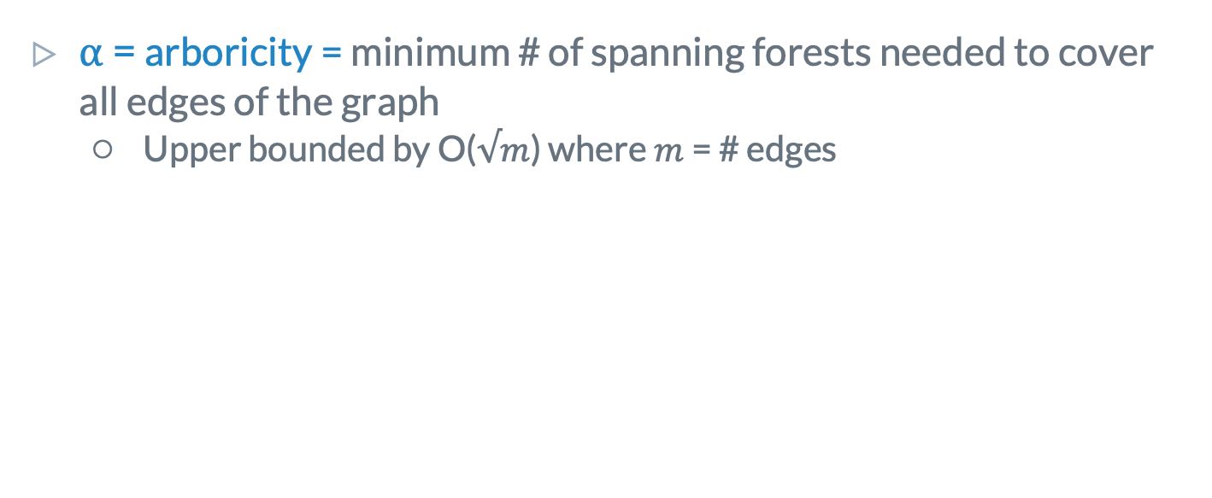
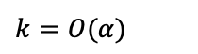
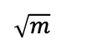
Graph orientation
⍺ = arboricity = minimum # of spanning forests needed to cover all edges of the graph
Upper bounded by O($√m$) where $m$ = # edges
$$\sqrt{m}$$
$$k=O(α)$$

Slide 25
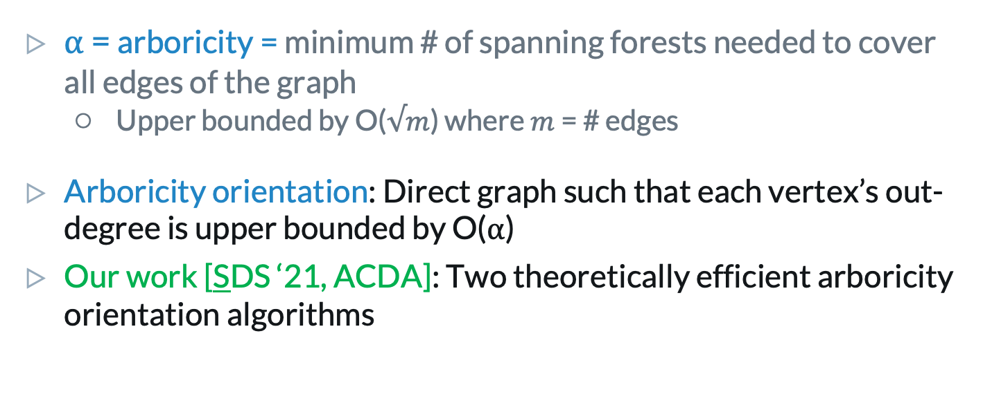
Graph orientation
⍺ = arboricity = minimum # of spanning forests needed to cover all edges of the graph
Upper bounded by O($√m$) where $m$ = # edges
Arboricity orientation: Direct graph such that each vertex’s out-degree is upper bounded by O(⍺)
Our work [SDS ‘21, ACDA]: Two theoretically efficient arboricity orientation algorithms

Slide 26
Parallel s-clique counting
Theory: Arboricity orientation
Systems: Cache-efficient data structures
O(s log n + log² n) span with high probability
Reduces span (sequential dependencies)
Reduces irregular memory accesses
O(m + P⍺) space
Reduces memory usage
Reduces memory usage
26

Slide 27
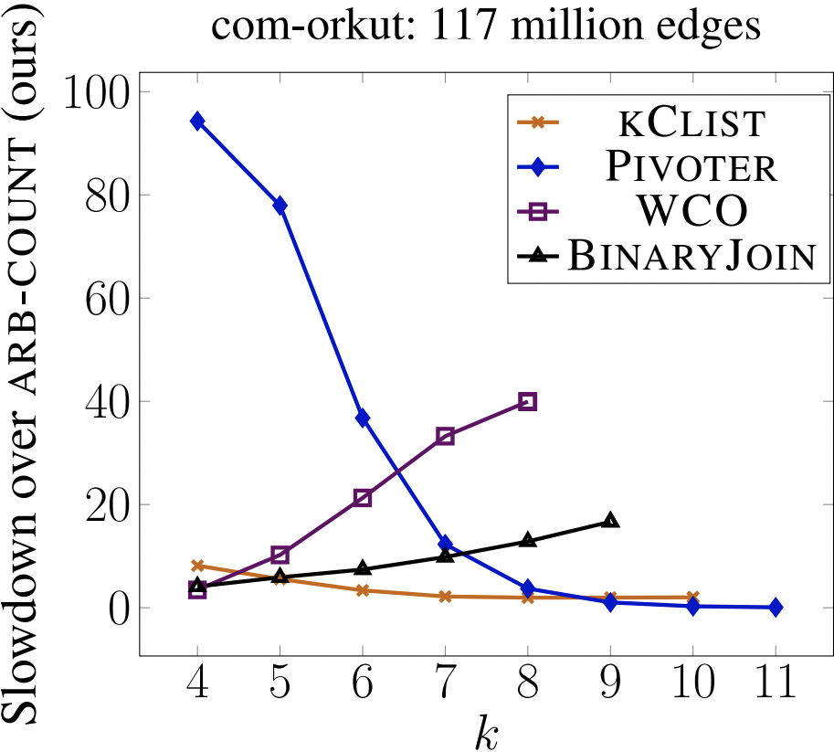
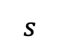
Results: Parallel s-clique counting
kClist: High span
Pivoter / WCO / BinaryJoin: Not work-efficient
Theory: Eliminate sequential dependencies
Theory: Reduce work
$$s$$

Slide 28
Results: Parallel s-clique counting
First to obtain 4-clique counts on:
ClueWeb (74 billion edges) in < 2 hours
Hyperlink2014 (~100 billion edges) in < 4 hours
Hyperlink2012 (~200 billion edges) in < 45 hours
Other implementations run out of memory on these graphs
Theory + Systems: Reduces memory usage

Slide 29
Outline
Parallel nucleus decomposition
Arboricity orientations + s-clique counting [SDS ‘21, ACDA]
Nucleus decomposition [SDS ‘22, VLDB]
Other parallel clustering algorithms
Correlation clustering [SDEŁM ‘21, VLDB]
Hierarchical agglomerative clustering (HAC) [DEŁMS ‘22, NeurIPS], [DEŁMS ‘21, ICML]

Slide 30
(r, s)-nucleus decomposition (r=2, s=3)
Direct the graph using an arboricity orientation
a
b
d
c
e

Slide 31
(r, s)-nucleus decomposition (r=2, s=3)
Direct the graph using an arboricity orientation
a
b
d
c
e

Slide 32
(r, s)-nucleus decomposition (r=2, s=3)
Direct the graph using an arboricity orientation
Count # s-cliques per r-clique
Construct a bucketing structure mapping r-cliques to a bucket based on # s-cliques
a
b
d
c
e
1 triangle: ce, de
2 triangles: ab, ac, ad, bc, bd
3 triangles: cd

Slide 33
(r, s)-nucleus decomposition (r=2, s=3)
Direct the graph using an arboricity orientation
Count # s-cliques per r-clique
Construct a bucketing structure mapping r-cliques to a bucket based on # s-cliques
While not all r-cliques have been peeled:
Peel set of r-cliques with minimum s-clique count
Update s-clique counts of remaining r-cliques
a
b
d
c
e
1 triangle: ce, de
2 triangles: ab, ac, ad, bc, bd
3 triangles: cd

Slide 34
(r, s)-nucleus decomposition (r=2, s=3)
Direct the graph using an arboricity orientation
Count # s-cliques per r-clique
Construct a bucketing structure mapping r-cliques to a bucket based on # s-cliques
While not all r-cliques have been peeled:
Peel set of r-cliques with minimum s-clique count
Update s-clique counts of remaining r-cliques
a
b
d
c
e
1 triangle: ce, de
2 triangles: ab, ac, ad, bc, bd
3 triangles: cd

Slide 35
(r, s)-nucleus decomposition (r=2, s=3)
Direct the graph using an arboricity orientation
Count # s-cliques per r-clique
Construct a bucketing structure mapping r-cliques to a bucket based on # s-cliques
While not all r-cliques have been peeled:
Peel set of r-cliques with minimum s-clique count
Update s-clique counts of remaining r-cliques
a
b
d
c
e
1 triangle:
2 triangles: ab, ac, ad, bc, bd, cd
3 triangles:

Slide 36
(r, s)-nucleus decomposition (r=2, s=3)
Direct the graph using an arboricity orientation
Count # s-cliques per r-clique
Construct a bucketing structure mapping r-cliques to a bucket based on # s-cliques
While not all r-cliques have been peeled:
Peel set of r-cliques with minimum s-clique count
Update s-clique counts of remaining r-cliques
a
b
d
c
e
1 triangle:
2 triangles: ab, ac, ad, bc, bd, cd
3 triangles:

Slide 37
(r, s)-nucleus decomposition (r=2, s=3)
Direct the graph using an arboricity orientation
Count # s-cliques per r-clique
Construct a bucketing structure mapping r-cliques to a bucket based on # s-cliques
While not all r-cliques have been peeled:
Peel set of r-cliques with minimum s-clique count
Update s-clique counts of remaining r-cliques
a
b
d
c
e
1 triangle:
2 triangles: ab, ac, ad, bc, bd, cd
3 triangles:

Slide 38
(r, s)-nucleus decomposition
Direct the graph using an arboricity orientation
Count # s-cliques per r-clique
Construct a bucketing structure mapping r-cliques to a bucket based on # s-cliques
While not all r-cliques have been peeled:
Peel set of r-cliques with minimum s-clique count
Update s-clique counts of remaining r-cliques
[SDS ‘21, ACDA]
[SDS ‘21, ACDA]

Slide 39
(r, s)-nucleus decomposition
Direct the graph using an arboricity orientation
Count # s-cliques per r-clique
Construct a bucketing structure mapping r-cliques to a bucket based on # s-cliques
While not all r-cliques have been peeled:
Peel set of r-cliques with minimum s-clique count
Update s-clique counts of remaining r-cliques
[SDS ‘21, ACDA]
[SDS ‘21, ACDA]
Subgoal 1
Subgoal 2

Slide 40
Prior parallel nucleus decomposition: PND ^{[1]}
Not fully parallel: Used a sequential heap to maintain r-cliques with minimum s-clique counts
Not space-efficient: Only implemented up to r=3, s=4
Theory + Systems: Long sequential dependencies
> 80,000x sequential rounds compared to our work
Systems: High memory usage
[1] Sariyuce, Seshadhri, Pinar (VLDB ‘18)
Notes:
Theoretically, batch-parallel Fibonacci heap from previous work by myself and Julian for subgoal 1
For subgoal 2, we prove an important lemma…
Say we’ll replace fib heaps with something we’ll talk about next
Key lemma:
But in practice, for subgoal 1, we use a parallel bucketing structure – the structure requires a mapping from r-cliques to unique keys, and we must also be able to efficiently decode the vertices that make up the r-cliques
So, a parallel hash table:
Optimization 1: # hash table levels
But we’ve lost some nice properties of using a single level hash table:
Optimization 2: contiguous space in hash table
Optimization 3: for one level tables, we can easily decode vertices that make up the r-clique corresponding to a key just by going to its location in memory. But what about if we just know the location in mem of the last level hash table? We don’t have a way to go back up. Binary search using prefix sum vs stored pointers here.
For subgoal 2:
We do theoretically efficient updating using a modification to our parallel clique counting subroutine
But to update the bucketing structure, we need to aggregate r-cliques with updated s-clique counts
Optimization 4: simple array, list buffer, hash table

Slide 41
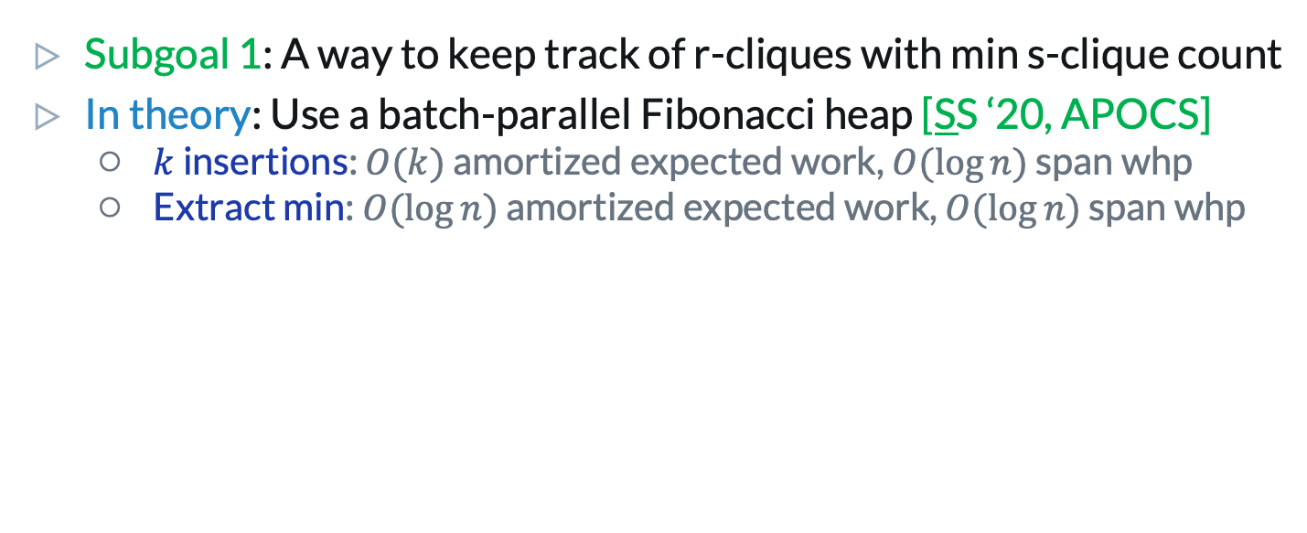
How do we peel r-cliques?
Subgoal 1: A way to keep track of r-cliques with min s-clique count
In theory: Use a batch-parallel Fibonacci heap [SS ‘20, APOCS]
$k$ insertions: $O(k)$ amortized expected work, $O(\log{n})$ span whp
Extract min: $O(\log{n})$ amortized expected work, $O(\log{n})$ span whp
Theory: Eliminate sequential dependencies
Theory: Reduces work

Slide 42
In practice: Keep track of r-cliques
Subgoal 1: A way to keep track of r-cliques with min s-clique count
In practice: Fibonacci heaps are not efficient
Systems: Irregular memory accesses
Systems: High memory usage

Slide 43
In practice: Keep track of r-cliques
Subgoal 1: A way to keep track of r-cliques with min s-clique count
In practice: Fibonacci heaps are not efficient
Julienne: Efficient parallel bucketing structure ^{[1]}
Requirement: Mapping between r-cliques and unique keys
[1] Dhulipala, Blelloch, Shun (SPAA ‘17)

Slide 44
In practice: Map r-cliques to keys
An option for space savings:
Two-level: Array and hash table
Keys = index of r-clique in last-level tables, Values = # incident s-cliques
Additional optimization for cache behavior: Store last-level tables contiguously in memory
a | b | c | d | e
(e, 1)
(d, 2) |  | (c, 2)
(b, 2) | (d, 2) | (c, 2)
(d, 3) | (e, 1)

Slide 45
In practice: Map r-cliques to keys
Space savings compared to standard hash table:
Up to 1.8x reduction in space usage on (2, 3)-nucleus and (2, 4)-nucleus
Up to 2.2x reduction in space usage on (3, 4)-nucleus
Up to 2.5x reduction in space usage on (4, 5)-nucleus
An option for space savings:
Two-level array and hash table:
Keys = index of r-clique in last-level tables, Values = # s-cliques
Additional optimization for cache behavior: Store last-level tables contiguously in memory
a | b | c | d | e | f
(e, 1)
(d, 2) |  | (c, 2)
(d, 3) | (e, 1)
(b, 2) | (d, 2) | (c, 2)
Systems: Reduces irregular memory accesses
Systems: Reduces memory usage

Slide 46
In practice: Map keys to r-cliques
Our work: Space-efficient solution to maintain inverse map (keys to r-cliques)
a | b | c | d | e
(b, 2) | (d, 2) |  | (c, 2) |  | (d, 2) |  | (c, 2) |  | (d, 3) | (e, 1) |  | (e, 1)
Systems: Reduces memory usage

Slide 47
(r, s)-nucleus decomposition
Direct the graph using an arboricity orientation
Count # s-cliques per r-clique
Construct a bucketing structure mapping r-cliques to a bucket based on # s-cliques
While not all r-cliques have been peeled:
Peel set of r-cliques with minimum s-clique count
Update s-clique counts of remaining r-cliques
[SDS ‘21, ACDA]
[SDS ‘21, ACDA]
Subgoal 1
Subgoal 2

Slide 48
How do we update s-clique counts?
Subgoal 2: A way to update s-clique counts after “deleting” r-cliques
In theory and practice: We improve upon the previous best theoretical bounds for sequential nucleus decomposition
Theory: Reduces work

Slide 49
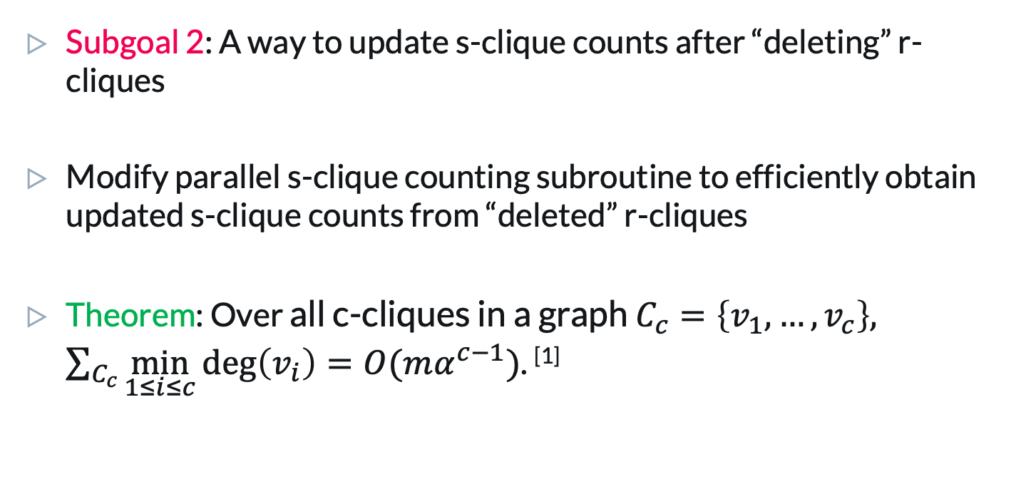
How do we update s-clique counts?
Subgoal 2: A way to update s-clique counts after “deleting” r-cliques
Modify parallel s-clique counting subroutine to efficiently obtain updated s-clique counts from “deleted” r-cliques
Theorem: Over all c-cliques in a graph $C_{c}=\left\{v_{1},…,v_{c}\right\},$ $\sum_{C_{c}}{\min_{1≤i≤c}{\deg\left(v_{i}\right)=O(mα^{c−1})}}$. ^{[1]}
[1] Eden, Ron, Seshadhri 2020

Slide 50
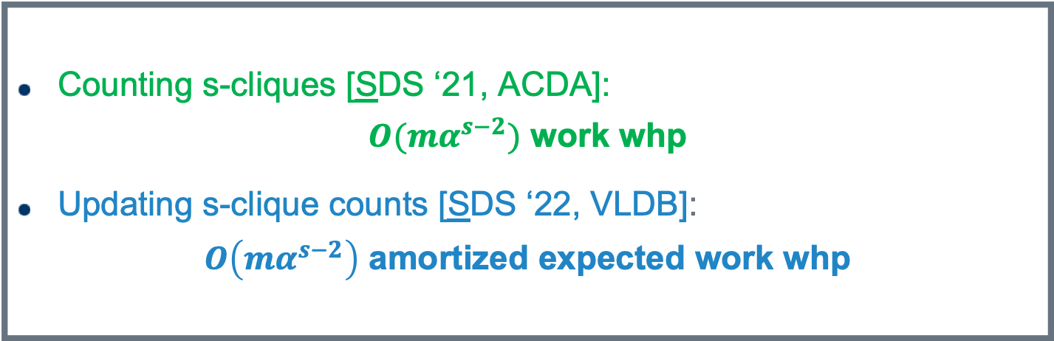
How do we update s-clique counts?
Counting s-cliques [SDS ‘21, ACDA]:
$O(mα^{s−2})$ work whp
Updating s-clique counts [SDS ‘22, VLDB]:
$O\left(mα^{s−2}\right)$ amortized expected work whp
Subgoal 2: A way to update s-clique counts after “deleting” r-cliques
In theory and practice: We improve upon the previous best theoretical bounds for sequential nucleus decomposition
Theory: Reduces work

Slide 51
(r, s)-nucleus decomposition
Direct the graph using an arboricity orientation
Count # s-cliques per r-clique
Construct a bucketing structure mapping r-cliques to a bucket based on # s-cliques
While not all r-cliques have been peeled:
Peel set of r-cliques with minimum s-clique count
Update s-clique counts of remaining r-cliques
[SDS ‘21, ACDA]
[SDS ‘21, ACDA]
Subgoal 1
Subgoal 2

Slide 52
(r, s)-nucleus decomposition
Direct the graph (DG) using an arboricity orientation
Count # s-cliques per r-clique using DG
Construct a bucketing structure mapping r-cliques to a bucket based on # s-cliques
While not all r-cliques have been peeled:
Peel set of r-cliques with minimum s-clique count
Update s-clique counts of remaining r-cliques
[SS ‘20, APOCS]
Practical optimizations:
Up to a 5x speedup over our unoptimized parallel nucleus decomposition
Up to a 2.5x reduction in space over our unoptimized parallel nucleus decomposition
[SDS ‘21, ACDA]
Subgoal 1
Subgoal 2

Slide 53
Environment
30-core GCP instance (2-way hyperthreading), 240 GB main memory
Used real-world Stanford Network Analysis Platform (SNAP) graphs

Slide 54
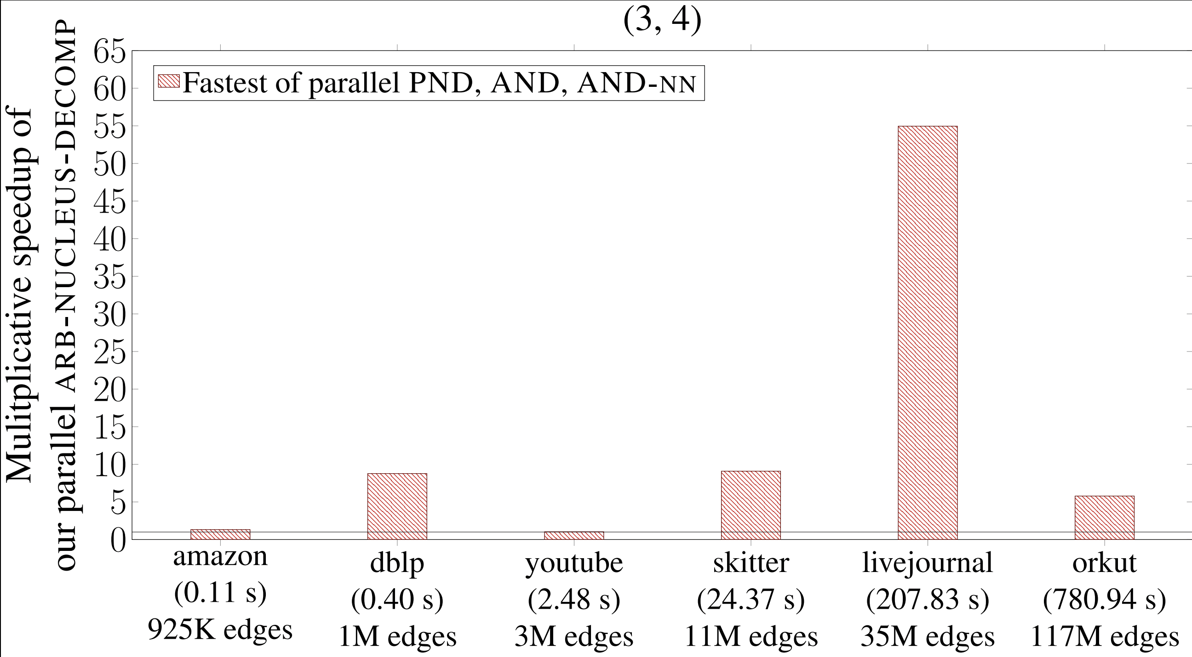
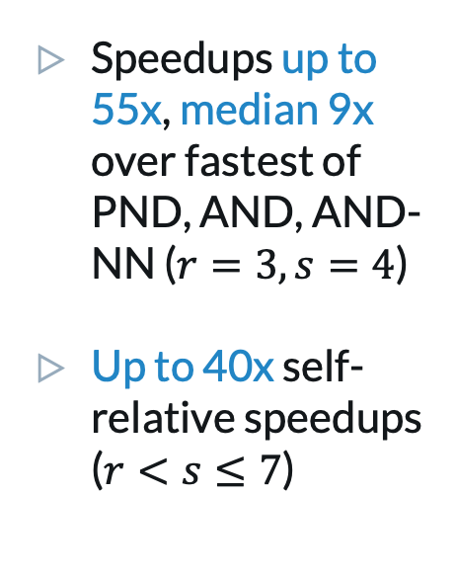
Comparison to other implementations
Speedups up to 55x, median 9x over fastest of PND, AND, AND-NN ($r=3, s=4$)
Up to 40x self-relative speedups ($r<s≤7$)
1
AND, AND-NN, PND: Sariyuce, Seshadhri, Pinar (VLDB ‘18)

Slide 55
Other implementations are not theoretically efficient
PND: Large span
AND: Not work-efficient
AND-NN: Not work-efficient and higher memory usage than PND + AND
PND, AND, and AND-NN: Not space-efficient (do not scale to larger r, s)
Theory: Eliminate sequential dependencies
Theory: Reduce work
Systems: Reduce memory usage

Slide 56
Other results
Approximate nucleus decomposition
Hierarchy construction for nucleus decomposition
Theory: Eliminate sequential dependencies
Theory: Strong guarantees
Systems: Fast in practice

Slide 57
Outline
Parallel nucleus decomposition
Arboricity orientations + s-clique counting [SDS ‘21, ACDA]
Nucleus decomposition [SDS ‘22, VLDB]
Other parallel clustering algorithms
Correlation clustering [SDEŁM ‘21, VLDB]
Hierarchical agglomerative clustering (HAC) [DEŁMS ‘22, NeurIPS], [DEŁMS ‘21, ICML]

Slide 58
Parallel clustering
[DEŁMS ‘22, NeurIPS], [SDEŁM ‘21, VLDB],
[DEŁMS ‘21, ICML]
[LSYDS ‘22, SPAA Best Paper], [SDS ‘22, VLDB], [SDS ‘21, ACDA], [HWSS ‘23, APOCS], [SS ‘20, APOCS]

Slide 59
Graph clustering
Search systems
Image similarity
k-anonymity / privacy
Recommendation systems
Spam detection

Slide 60
My research: Graph clustering
Local search
Subgraph decomposition
Scalable community detection via parallel correlation clustering (VLDB ‘21)
Parallel batch-dynamic k-core decomposition (SPAA Best Paper ‘22)
Theoretically and practically efficient parallel nucleus decomposition (VLDB ‘22)
Efficient algorithms for parallel bi-core decomposition (APOCS ’23)
Parallel clique counting and peeling algorithms (ACDA ’21)
Parallel algorithms for butterfly computations (APOCS ’20)
Hierarchical clustering
Hierarchical agglomerative graph clustering in poly-logarithmic depth (NeurIPS ’22)
Hierarchical agglomerative graph clustering in nearly linear time (ICML ‘21)

Slide 61
Correlation clustering [SDEŁM ‘21, VLDB]
Main goal: Scalable graph clustering framework Par-CC with high-quality on ground truth data
LambdaCC objective ^{[1]}: Generalized objective unifying quality measures (modularity, sparsest cut, cluster deletion)
Currently used in production at Google
[1] Veldt, Gleich, Wirth (WWW ‘18)

Slide 62
Correlation clustering: Improvements
Systems: Relax sequential dependencies heuristically (symmetry breaking)
Systems: Quality / speed tradeoffs with hierarchical refinements
Up to 2.5x speedups and 156% increase in objective
Up to 2.3x slowdowns, but 37% increase in objective
Systems: Heuristics to reduce work
Up to 2x speedups

Slide 63
Correlation clustering: Improvements
Systems: Relax sequential dependencies heuristically (symmetry breaking)
Systems: Quality / speed tradeoffs with hierarchical refinements
Up to 5.9x speedups using these optimizations
Up to a 156% increase in objective using these optimizations
Up to 2.5x speedups and 156% increase in objective
Up to 2.3x slowdowns, but 37% increase in objective
Systems: Reduce incremental work
Up to 2.0x speedups

Slide 64
Correlation clustering: Environment
30-core GCP instance (2-way hyper-threading), 240 GB main memory
48-core GCP instance (2-way hyper-threading), 1.4 TB main memory for large graphs
Graphs with ground-truth communities:
Unweighted real-world Stanford Network Analysis Platform (SNAP) graphs with up to 1.8 billion edges
Weighted graphs from computing k-NN on real-world pointsets from the UCI Machine Learning repository

Slide 65
Correlation clustering: Comparison to existing baselines
Pivot-based correlation clustering:
C4, ClusterWild! ^{[1]} are up to 429x faster than Par-CC
C4, ClusterWild! give a 273 – 433% decrease in objective compared to Par-CC
Systems: C4, ClusterWild! do not take into account heuristic improvements
[1] Pan et al. (NeurIPS ‘15)

Slide 66
Correlation clustering: Comparison to existing baselines
Parallel modularity clustering:
Par-Mod is up to 3.5x faster than NetworKit ^{[1]}
Triangle-based clustering:
Par-CC is up to 67.6x faster than TECTONIC ^{[2]}
Theory: Par-Mod uses work-efficient + polylogarithmic span graph contraction
[1] Staudt, Meyerhenke (TPDS ‘16)
[2] Tsourakakis, Pachocki, Mitzenmacher (WWW ‘17)

Slide 67
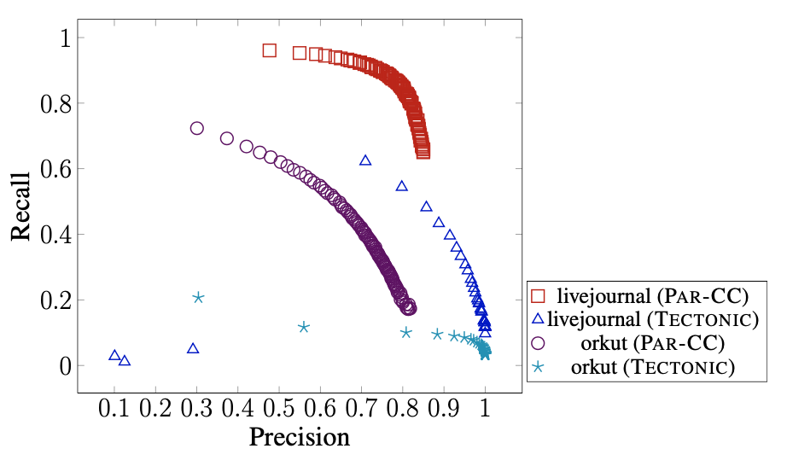
Correlation clustering: Comparison to ground truth

Slide 68
Hierarchical agglomerative clustering (HAC) [DEŁMS ‘22, NeurIPS], [DEŁMS ‘21, ICML]
Main goal: Scalable hierarchical clustering framework with high-quality on ground truth data
Theory: Improves exact bounds using dynamic arboricity-orientation
Theory: Poly-logarithmic span using approximation techniques
Systems: Efficient compressed data structure for contracted graphs

Slide 69
ParHAC: Environment
72-core Dell PowerEdge R930 (2-way hyper-threading), 4 x 18-core E7-8867 v4 Intel Xeon procesors, 1 TB main memory
Graphs with ground-truth communities:
Unweighted real-world Stanford Network Analysis Platform (SNAP) graphs with up to 1.8 billion edges
Weighted graphs from computing k-NN on real-world pointsets from the UCI Machine Learning repository

Slide 70
ParHAC: Comparison to other baselines
Average 86x speedup to sequential approximate HAC
Slower than Affinity ^{[1]} and Sub-Cluster Component (SCC) ^{[2]}, but substantial quality improvements
Theory: Affinity and SCC are heuristic parallelizations of HAC, whereas ParHAC has theoretical approximation guarantees
[1] Bateni et al. (NeurIPS ‘17)
[2] Monath et al. (KDD ‘21)

Slide 71
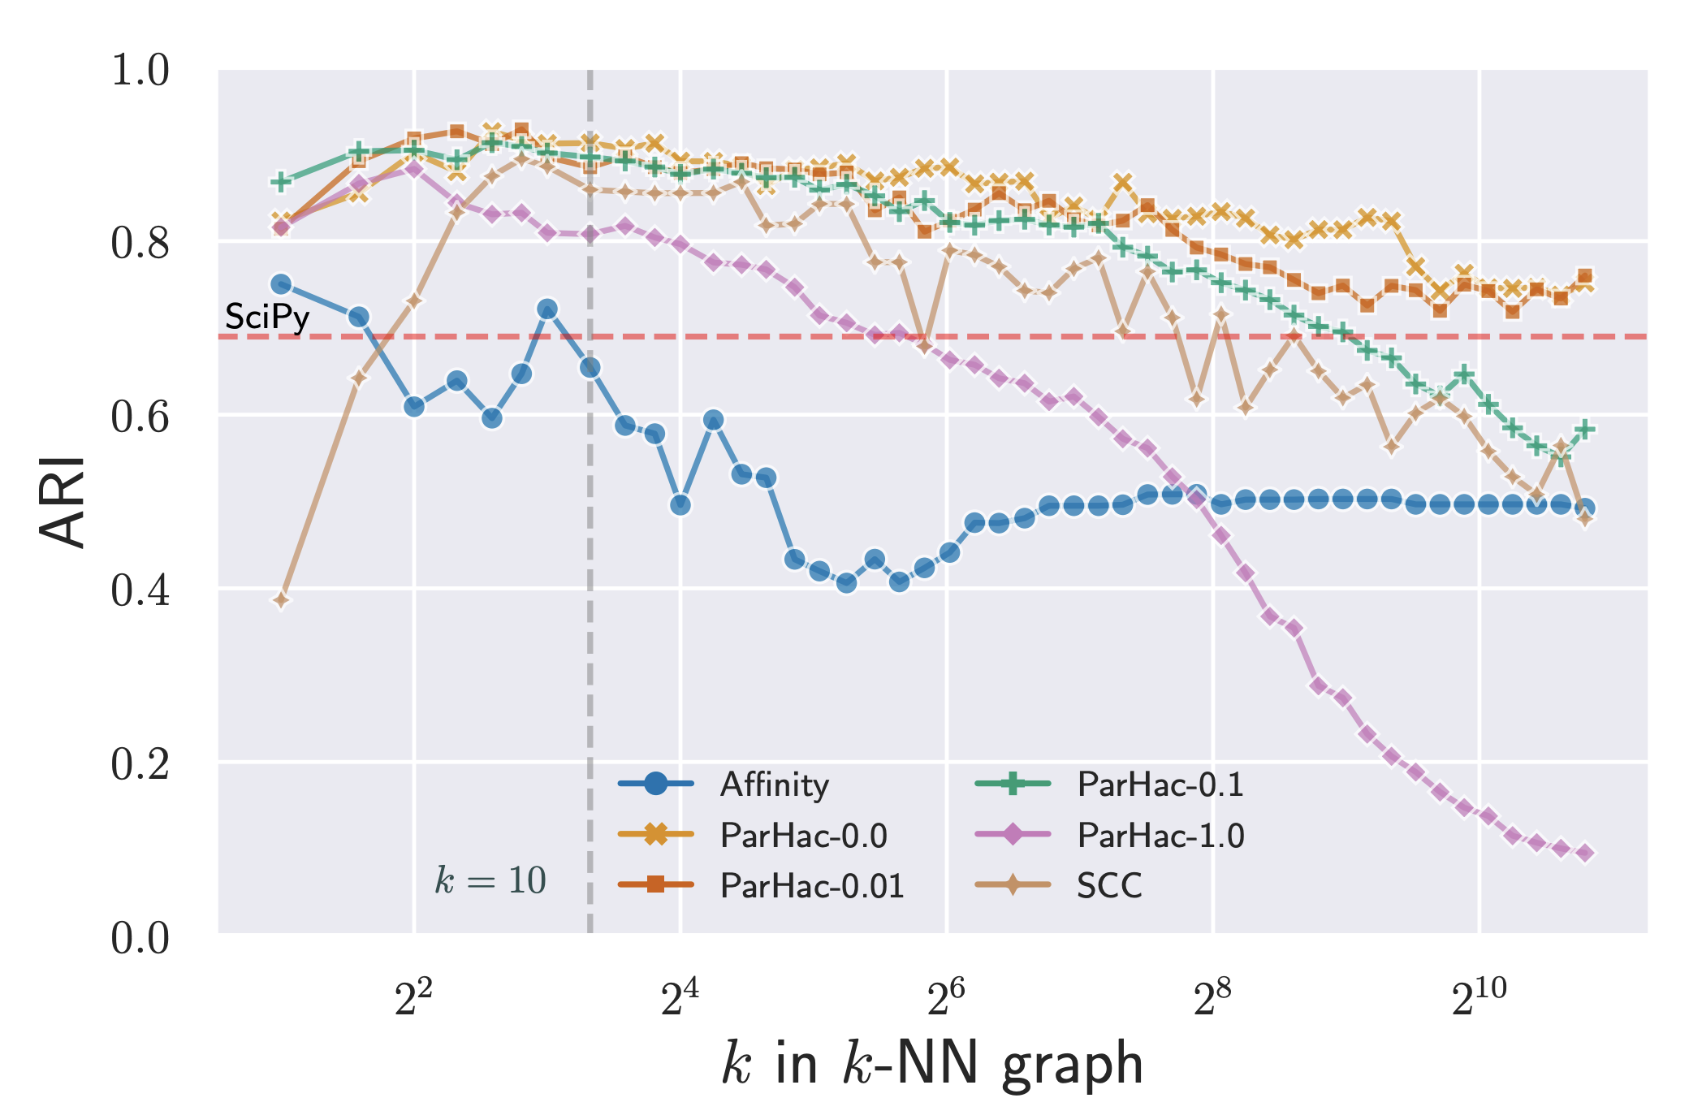
ParHAC: Comparison to other baselines

Slide 72
ParHAC: Comparison to other baselines
We are the first to implement shared-memory parallel Affinity ^{[1]} and Sub-Cluster Component (SCC) ^{[2]} clustering
Currently used in production at Google
[1] Bateni et al. (NeurIPS ‘17)
[2] Monath et al. (KDD ‘21)

Slide 73
ParHAC: Comparison to other baselines
We are the first to implement shared-memory parallel Affinity ^{[1]} and Sub-Cluster Component (SCC) ^{[2]} clustering
Our implementations are the first to cluster graphs with hundreds of billions of edges in tens of minutes (Affinity, SCC) to hours (SCC, ParHAC)
Currently used in production at Google
[1] Bateni et al. (NeurIPS ‘17)
[2] Monath et al. (KDD ‘21)

Slide 74
Conclusion

Slide 75
My research
My research combines theory and practice to construct scalable, real-world systems
Theory
Differential privacy (FOCS ‘22)
Systems
Hierarchical agglomerative clustering (NeurIPS ’22, ICML ‘21)
k-core + nucleus decomposition (SPAA Best Paper ‘22, VLDB ‘22)
Subgraph counting + peeling (ACDA ‘21, APOCS [‘23, ‘20], SEA ‘21, JEA ‘22)
Graph-based benchmark suite (GBBS) (GRADES-NDA ‘20)
Correlation clustering (VLDB ‘21)

Slide 76
Conclusion
Strong theoretical bounds
Arboricity orientations + s-clique counting [SDS ‘21, ACDA]
Nucleus decomposition [SDS ‘22, VLDB]
Hierarchical agglomerative clustering [DEŁMS ‘22, NeurIPS], [DEŁMS ‘21, ICML]
Reduce work
Eliminate sequential dependencies

Slide 77
Conclusion
Scalable implementations on real-world data
Arboricity orientations + s-clique counting [SDS ‘21, ACDA]
Nucleus decomposition [SDS ‘22, VLDB]
Correlation clustering [SDEŁM ‘21, VLDB]
Hierarchical agglomerative clustering [DEŁMS ‘22, NeurIPS], [DEŁMS ‘21, ICML]
Performance engineering
Real-world frameworks

Slide 78
Future Work
Clustering framework
Arboricity-based graph processing framework
How do we design modular frameworks with functional primitives for clustering?
How do different metrics compare in practice?
Can we develop strong theoretical bounds for other graph processing problems?
How do we design functional primitives for arboricity-based graph processing?

Slide 79


Acknowledgments: Thesis Committee
Vahab Mirrokni
Julian Shun
Laxman Dhulipala
Ronitt Rubinfeld

Slide 80


Acknowledgments: Julian’s Lab
Changwan Hong
Siddhartha Jayanti
Junhong Lin
Quanquan C. Liu
Tom Tseng
Yiqiu Wang
Shangdi Yu

Slide 81
Acknowledgments: Julian’s Lab
Linda Lynch

Slide 82

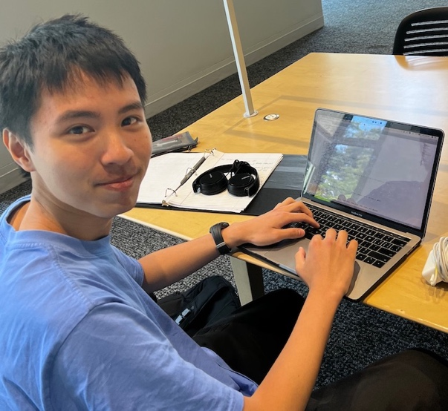

Acknowledgments: Collaborators
Jakub Łăcki
Guy Blelloch
David Eisenstat
Louisa Ruixue Huang
Yihao Huang
Sofya Raskhodnikova
Claire Wang

Slide 83
Acknowledgments
Google Research
Vincent Cohen-Addad
Mohammad Hossein Bateni
Xiaoen Ju
Sasan Tavakkol
David Applegate
Kevin Aydin
Matthew Fahrbach
Lars Gottesbüren

Slide 84
Acknowledgments
Graduate Women at MIT (GWAMIT)
Ylaine Gerardin
Michaela Gold
Graduate Counselor
Joel Emer
Too many friends to list

Slide 85

Acknowledgments
Heesu Hwang

Slide 86

Acknowledgments
Heemyung Hwang
(and their parents)

Slide 87

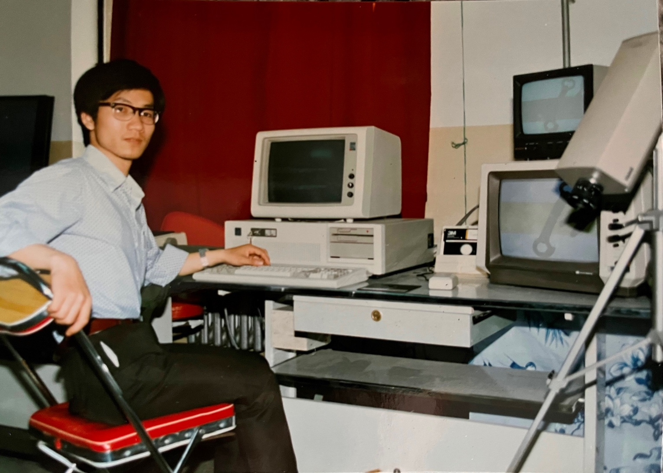
Acknowledgments: My Parents

Slide 88

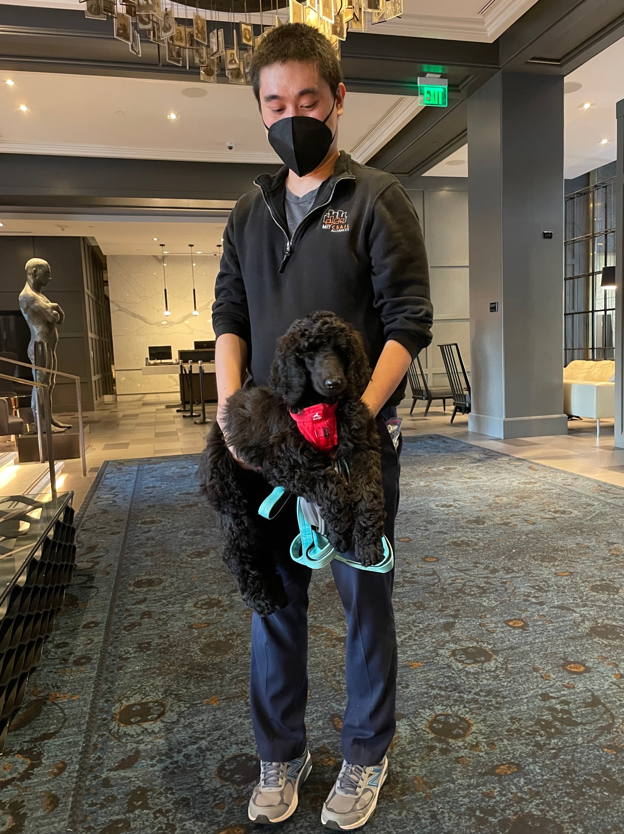
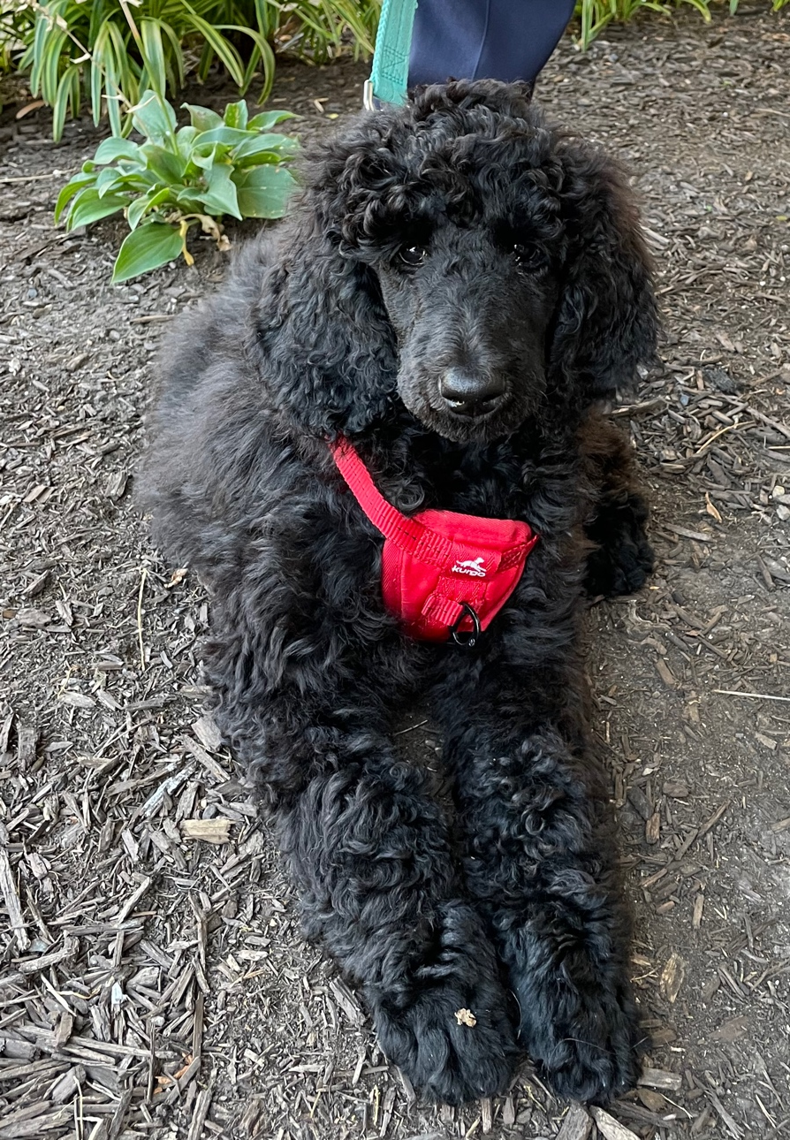
Acknowledgments: Nami

Slide 89

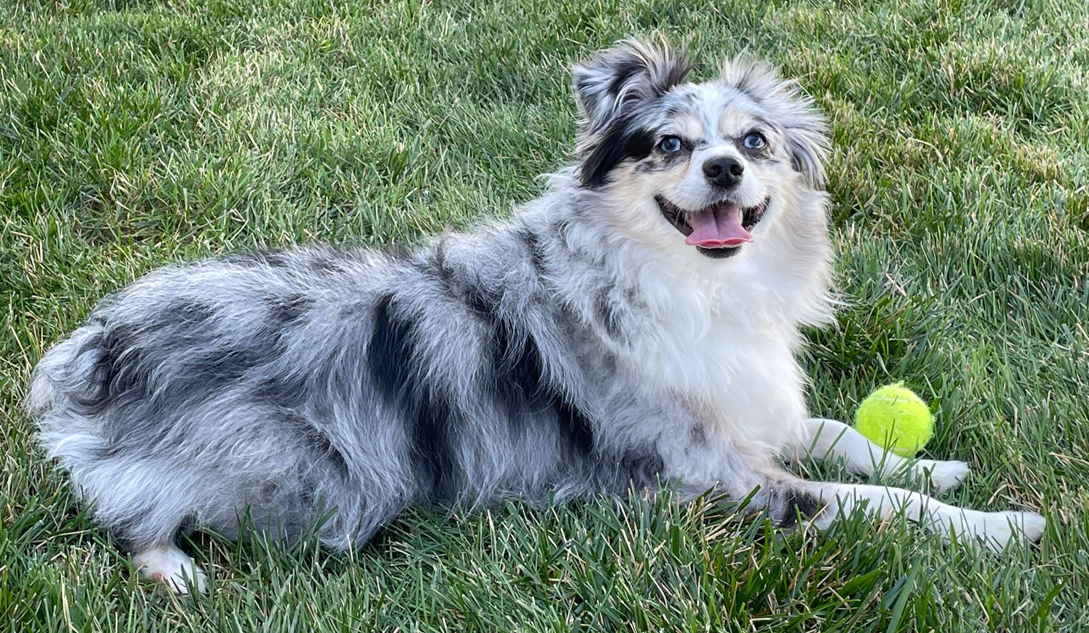
Acknowledgments: Avery

Slide 90
Thank you!

